Slide 1
Modeling Voter Behaviour and Electoral Dynamics using Cellular Automata
Aditya Joglekar 201401086
Rajdeep Pinge 201401103
Rushikesh Nalla 201401106
Omkar Damle 201401114

Slide 2
Basic 1: Voter model with local interaction - Linear voter model
Two Party System: Opinion 0 and opinion 1
Rules:
For every time step, an agent is selected at random.
The agent further selects a random neighbour in his Moore Neighbourhood and takes his opinion.
Periodic Boundary Condition

Slide 3
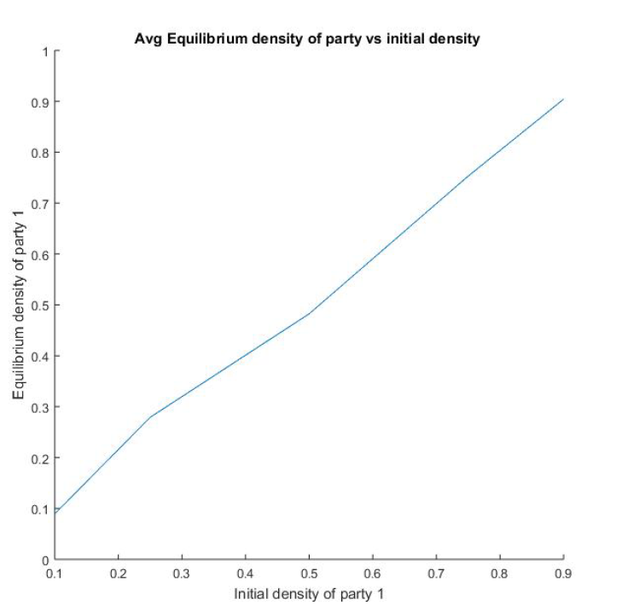
Basic model
Important observations -
Relation is linear
As if results are predetermined by initial density.
Even for initial density 0.9 on an average, the stronger opinion cannot establish complete dominance.
Weak are resilient. This is because of the rule which allows the minority to potentially contribute to the cell’s opinion.

Slide 4
Basic 2: Nonlinear voter models
Rules :
For every time step, an agent is selected at random.
The Von Neumann neighborhood of the agent is considered. The sum of the opinions of the five agents is considered (The opinion is either 0 or 1). A probability mass function is used to decide whether the agent remains with party/opinion 1.

Slide 5
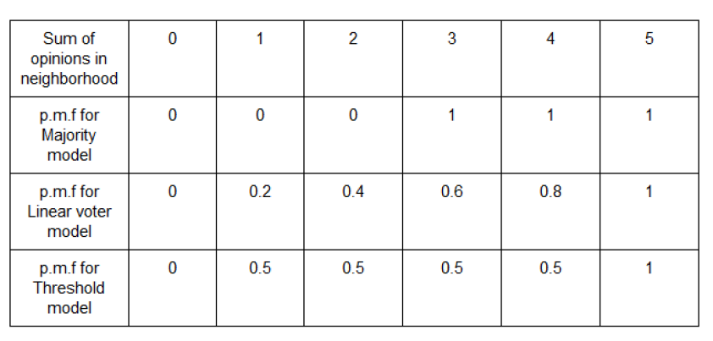
Probability mass functions of different models:

Slide 6
Sub Models
Majority rule model -
-The agent always goes with the majority in the group/locality.
-This reflects crowd mentality of being influenced by the majority rather than sticking to your own opinion.
2. Threshold model -
-The agents’ thinking is binary. If the neighborhood has absolute majority, they remain in the same state.
-Otherwise, the agent flips a coin to decide the party.
-Illiterate voters

Slide 7
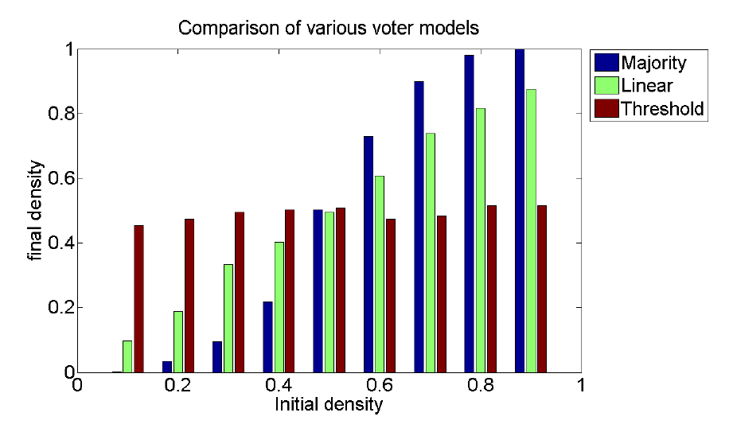
Comparison of linear and non-linear models:
- Grid size of 50*50 is used
- Number of Time steps = 30000

Slide 8
Basic 3: Random Discussion Groups
In this model, spatial locality (local neighbourhood) is not considered. In the real world, this model can be used to model voter behaviour due to interactions between voters in offices, markets, public transport facilities and other public places.
Rules:
In each discussion cycle, the entire population is divided into randomly sized discussion groups. The size of the discussion group is decided by a probability mass function.
The entire group adopts a single opinion decided by majority. In case of a tie, opinion 0 is adopted. This represents some sort of bias for opinion 0.

Slide 9
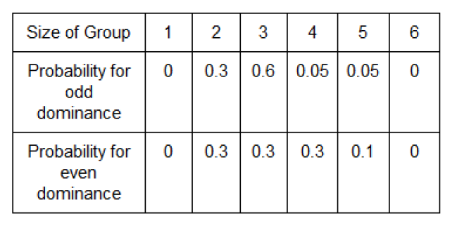
Probability mass function for different group sizes used for simulation

Slide 10
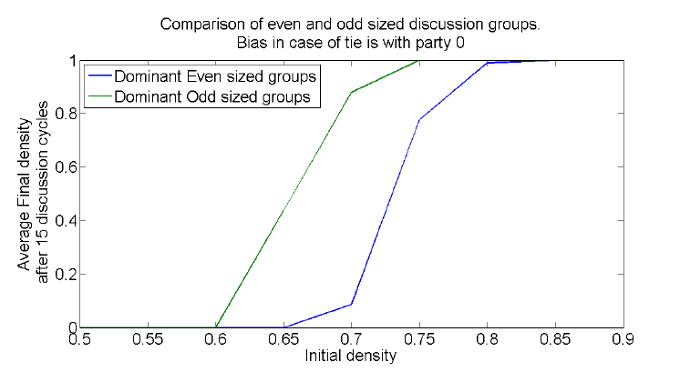
Random Discussion: Comparison of Even-Odd Group
Grid size - 20*20

Slide 11
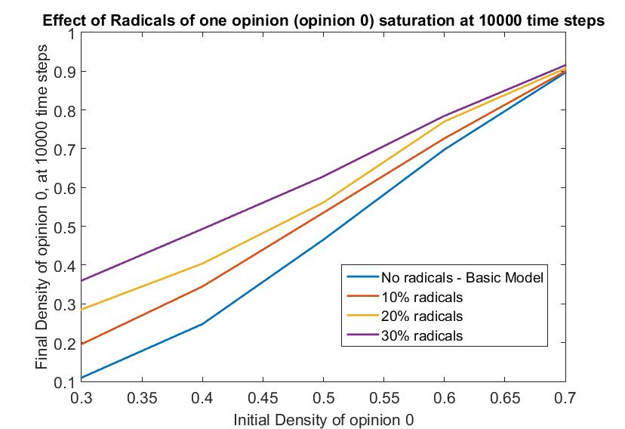
Extensions 1: Effect of Radicals
Extension of Majority Model
Radicals: Never change their opinion
Radicals of One opinion
Effect of radicals decreases with increase in initial density.

Slide 12
Extension 2: Tri-Party System
Basic Model: Random Discussion Group
Rules:
In each discussion cycle, the entire population is divided into discussion groups of size 3.
The entire group adopts a single opinion decided by majority of the 3 people.
In case of a tie,
Opinion A is adopted with probability α
Opinion B is adopted with probability β
Opinion C is adopted with probability (1 - α - β)

Slide 13
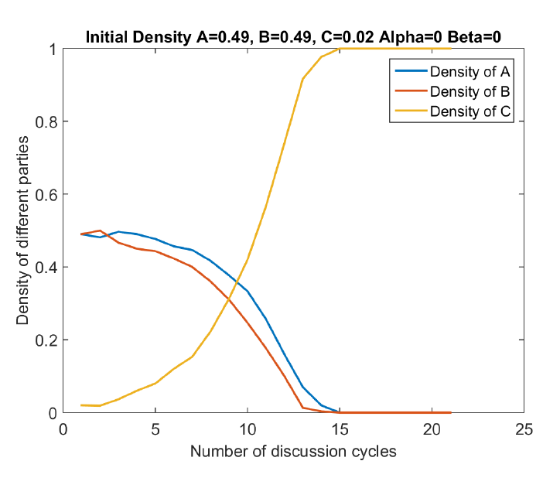
Case I
Initially no opinion has majority.
Grid - 30*30
Mathematics behind Opinion C winning
While two fight, the third wins!

Slide 14
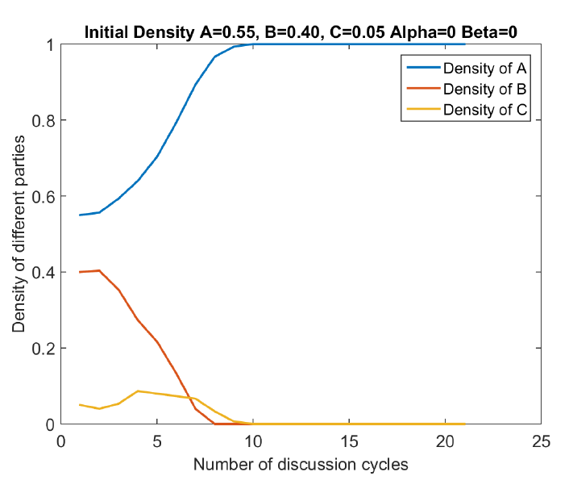
Case II
One opinion has clear Majority (>50%).
It eventually wins irrespective of other conditions.

Slide 15
Extension 3: Effect of Mass Media - Consensus
Media influence in a population with consensus based decision rule.
Basic Model: Global Effect of Media - Reaches Consensus (Media Opinion) - Trivial
Modification:
Rule:
Pick a random cell. Appoint cells in its Von Neumann neighbourhood as its advisers.
If they are able to reach a consensus, the cell takes their opinion.
If this fails, the person takes the opinion of the media with some probability p.

Slide 16
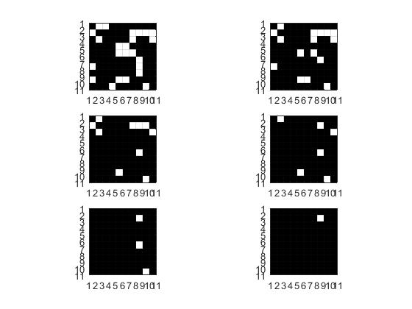
Media hegemony in consensus based society (p=1)
No. of Iterations = 200
Randomly initialize the grid with 50:50 density of opinions.
Media is able to quickly establish its hegemony over public opinion.
Probability of a consensus is just ⅛ for Von Neumann neighbourhood.

Slide 17
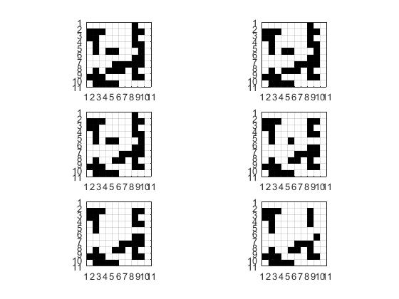
Stalemate when media is ineffective (p=0)

Slide 18
Effect of Mass Media
Consensus based systems are too boring. Can effect of media be studied in more interesting systems?
Use mass media in a system where decision making is very effective, a majority based system.
Can we use mass media to subversively?

Slide 19
Extension 3: Effect of Mass Media - Majority
Extension of majority model
Rules -
Same as in consensus, but this time the voter seeks media’s opinion in case a tie happens.
Note that the probability of media affecting the proceedings is low because ties happen rarely.
But we will see that in spite of this in some situations the media is able to influence the voter opinion.

Slide 20
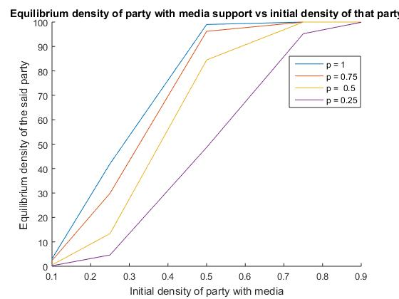
Influence of media in majority based system

Slide 21
Conclusion
Several factors considered in isolation to ensure we are able to analyze them systematically without them interacting with each other.
Simple local rules lead to emergent global behaviours which we can interpret and get insights about the real politics and complex voter behaviour.
Effect of Random Discussion Groups - more realistic insights.
Impact of important real world factors like mass media and radicals.
Tri-Party model to observe basic behaviour of multi-party systems.

Slide 22
References
Galam, Sociophysics: A review of Galam models. (2008)
Alexandru Agapie and Robin Hons, Analysis of a voter model, AMS 2000.
https://services.math.duke.edu/~rtd/survey/survc5.html.
S. Galam, Minority opinion spreading in random geometry, Eur. Phys. J. B 25, 403–406 (2002).
Nuno Crokidakis, Effects of mass media on opinion spreading in the Sznajd sociophysics model (2011)
S. Galam, F. Jacobs, The Role of Inflexible Minorities in the Breaking of Democratic Opinion Dynamics (2007)
S.Gekle, L.Pelitia and S.Galam, "Opinion Dynamics in a three-choice system", EDP Sciences, Springer-Verlog (2005).

Slide 23
Thank you! Long live democracy.
Any questions?

